Slide 1

Vehicles chasing each other around
a closed course with varying properties

Slide 2

Outline
DUAYENLER

Slide 3
DUAYENLER

Slide 4
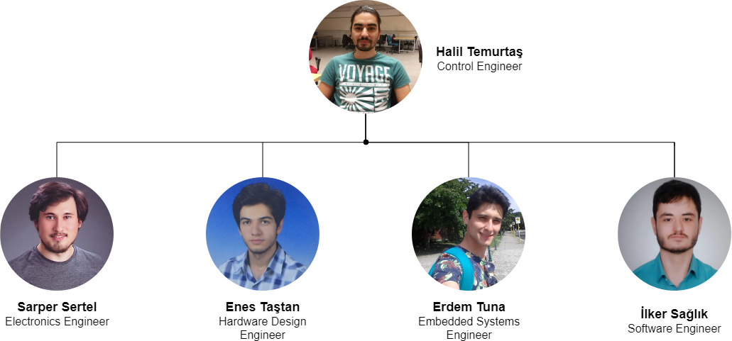
Team
DUAYENLER

Slide 5
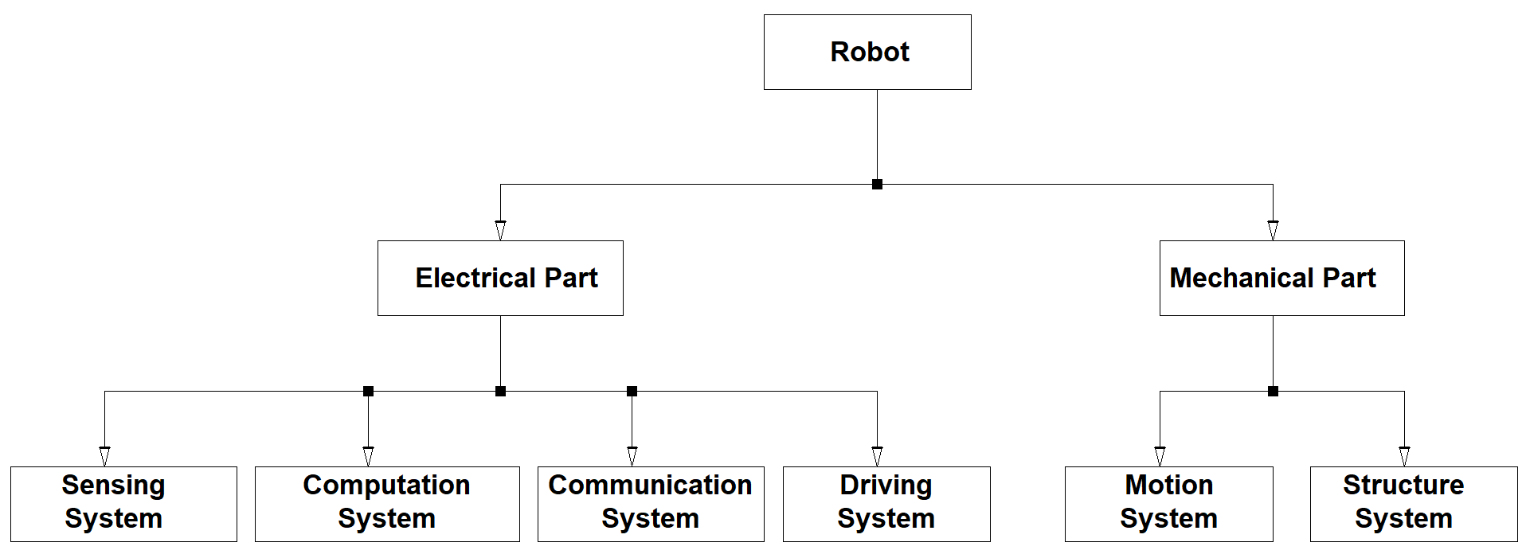
System Diagram
DUAYENLER

Slide 6
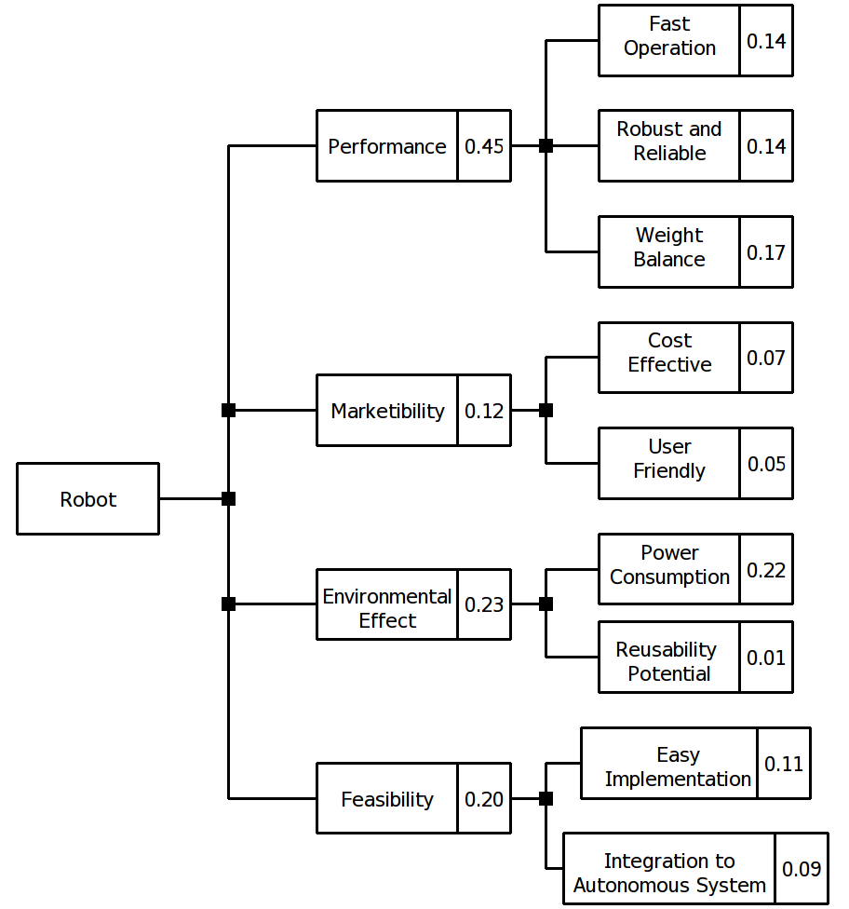
Objective Tree
DUAYENLER

Slide 7
Project Requirements
The vehicle should
detect the lane,
follow the lane,
detect the opponent and
communicate with the opponent.
DUAYENLER

Slide 8
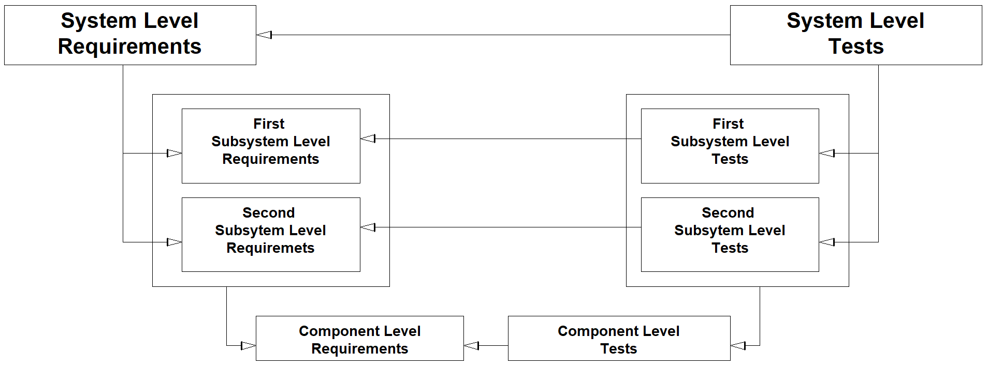
V-Model
DUAYENLER

Slide 9
Lane Detection Subsystem
Problem
Detecting lane lines out of a captured image in real time
DUAYENLER

Slide 10
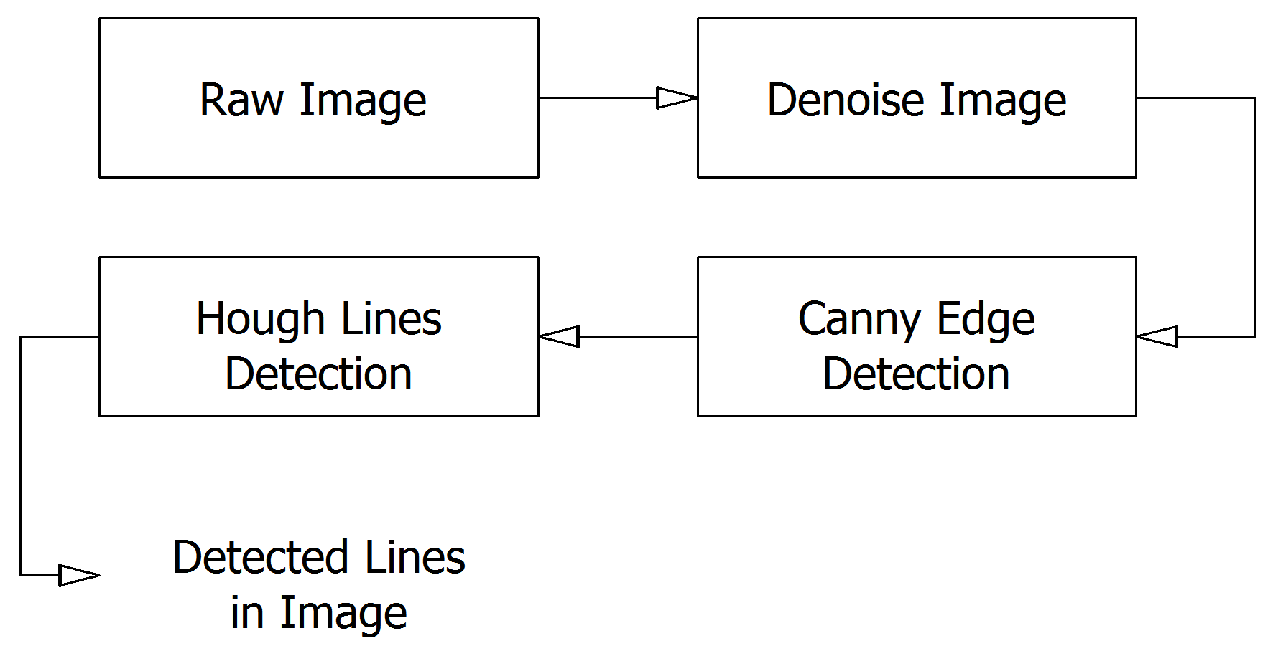
Lane Detection Subsystem
Solution
DUAYENLER

Slide 11
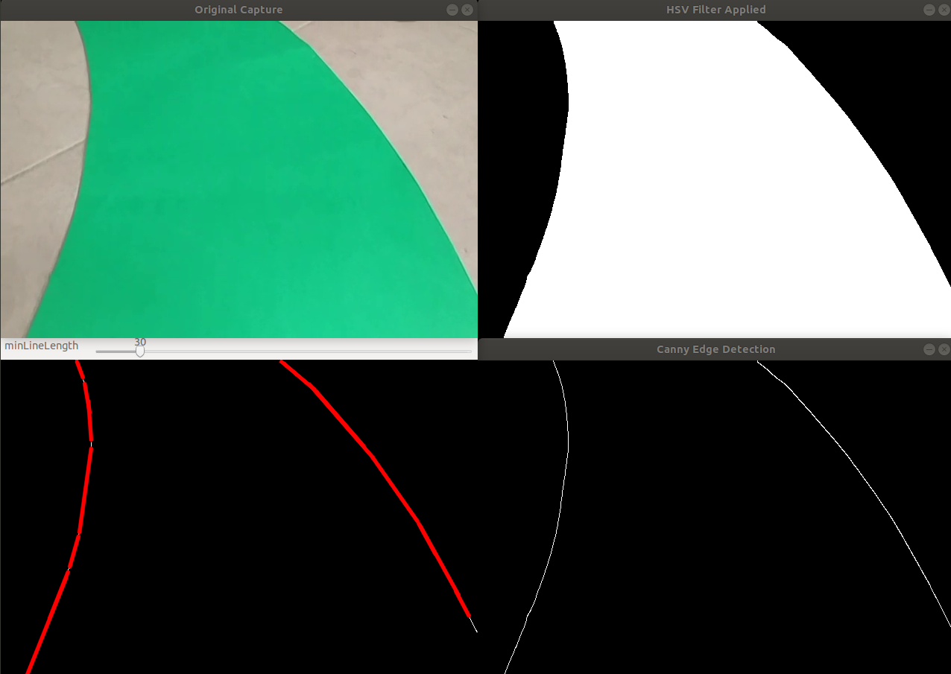
Lane Detection Subsystem
Sample Outputs of Color Filtering, Canny Edge Detection and Hough lines
DUAYENLER

Slide 12
Data Processing Subsystem
Problem
Determining the turn angle and direction out of the found lines in the image
DUAYENLER

Slide 13
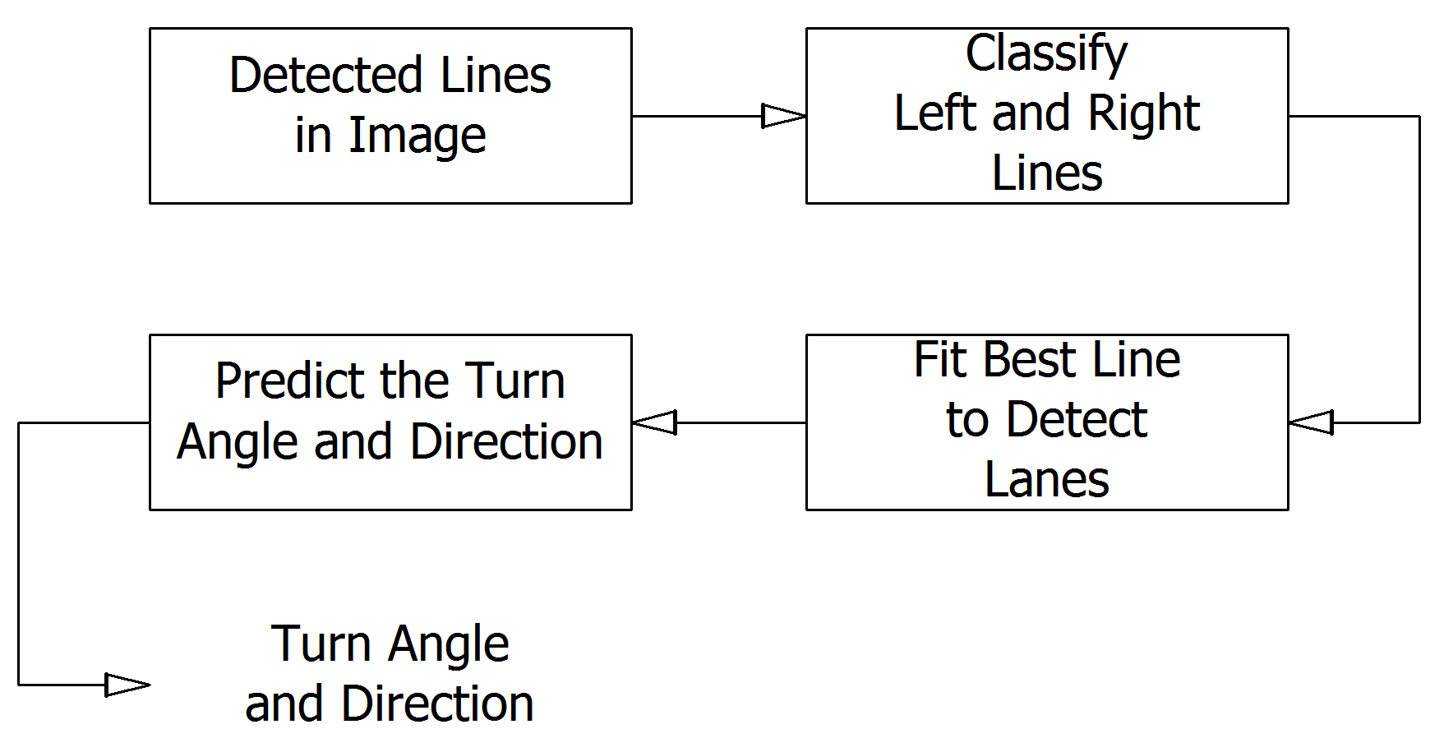
Data Processing Subsystem
Solution
DUAYENLER

Slide 14
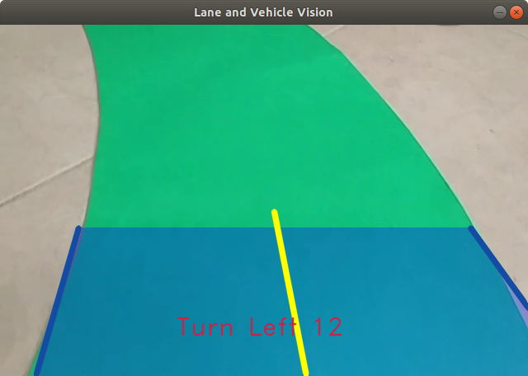
Data Processing Subsystem
Sample Output of Data Processing Subsystem
DUAYENLER

Slide 15
Lane Vision of the Vehicle
Sample Realtime Video Containing the Turn Angle and Direction
DUAYENLER

Slide 16
Power consumption
 | Current (Avg) A | Watt(Avg) W | Current (Max) A | Watt(Max) W
Raspberry pi | 0,85 | 4,25 | 2,5 | 12,5
Arduino | 80m | 0,4 | 0,2 | 1
Driver and DC Motors | 1,5 | 18 | 3 | 36
ToF sensors | 19m | 62.7m | 40m | 132m
Total power consumption | 2,45 | 22,71 | 5,74 | 49,6
DUAYENLER

Slide 17
Cost Analysis
Component | Price ($)
Raspberry pi | 48
Arduino | 5
Driver and DC Motors | 24.5
ToF sensors | 18
Wheels | 8
Powerbank | 12
Li-po Battery | 15
Additional components | 10
Additional payment | 15
Camera | 23
Chassis | 20
Total Project | 198,5
DUAYENLER

Slide 18
Deliverables
Technical manuals
Elliptical path
Rechargeable battery and the charger
The vehicle will have two (2) years of warranty
DUAYENLER

Slide 19
CONCLUSION
DUAYENLER

Slide 20
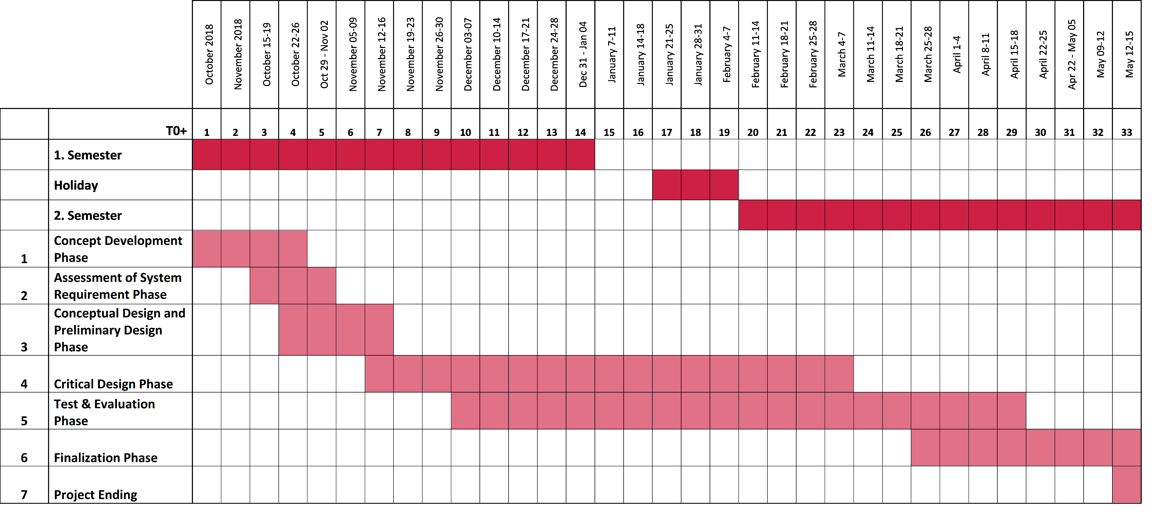
Gantt Chart
DUAYENLER

